Slide 1
205 Oct 7, Class 8
Writeup questions?
Within-participant design
Gino & Wiltermuth (2014)

Slide 2
In an effort to determine the effects of the drug chlorpromazine on the performance of schizophrenics, two clinical investigators randomly selected 20 acute schizophrenics from a mental hospital population.
The patients were asked to order several stimuli along some dimension, such as ordering eight stimuli by weight.
There were several tasks of this sort.
The investigators used a within-subject design in which all participants first performed the tasks after being injected with a saline solution (placebo) and then performed the tasks again several hours later after being injected with chlorpromazine.
The results indicated that fewer errors were made in the chlorpromazine treatment, which suggested to the investigators that the drug facilitates more adequate cognitive functioning in this type of patient.

Slide 3
Jones wondered if infants might begin the social control of facial expressions, including smiles even earlier than 18m. A laboratory testing situation was set up to observe 10m-old babies with their mothers. Two conditions were tested. In one, the mother paid attention to the baby for 6 min; in the other she read a magazine for 6 min. The baby was videotaped and smiles were later scored by judges who viewed the tapes. Babies smiled at their mothers more often when their mothers were attentive.

Slide 4
 | Mom watching | Mom reading
SN | 12 | 6
JF | 8 | 7
KM | 4 | 3
GB | 2 | 0
SB | 18 | 15
Avg | 8.8 (2.9) | 6.2 (2.5)

Slide 5
Smiling
Two-sample t-test assuming equal variances, t(8)=0.69, p>0.65

Slide 6
Smiling
Paired t-test, t(4)=2.83, p< .05

Slide 7
Within-participants design
Generally better
Except when it’s not
Advantages
Highly efficient. Each participant provides data in all conditions so accumulating data collection towards the planned number of participants is more rapid.
Perfect control of participant variables. Since all participants provided data on all conditions, the conditions are exactly matched for all extraneous variables related to the participants on the task, e.g., motivation, attention, ability.

Slide 8
Within-participant design concerns
History effects: carryover, learning, fatigue
Counterbalance order across participants
Be aware when this doesn’t work
Can require a factorial analysis (Chapters 9-11)
Participants aware of all IV levels
Might be aware of the experimental hypothesis
Might therefore be biased in responding

Slide 9
Questions
1. Why is it generally impractical to use a within-participants design in studies that have an element of deception (e.g., the implicit bias studies)?
2. For a study assessing time to recognize famous faces upside-down, why would a within-participants design be a good idea? Give two reasons.
3. Why are mood manipulation studies difficult to do as a within-participants design?
4. Why are learning-based studies difficult to do as a within-participants design?

Slide 10
G&W should be class 9

Slide 11
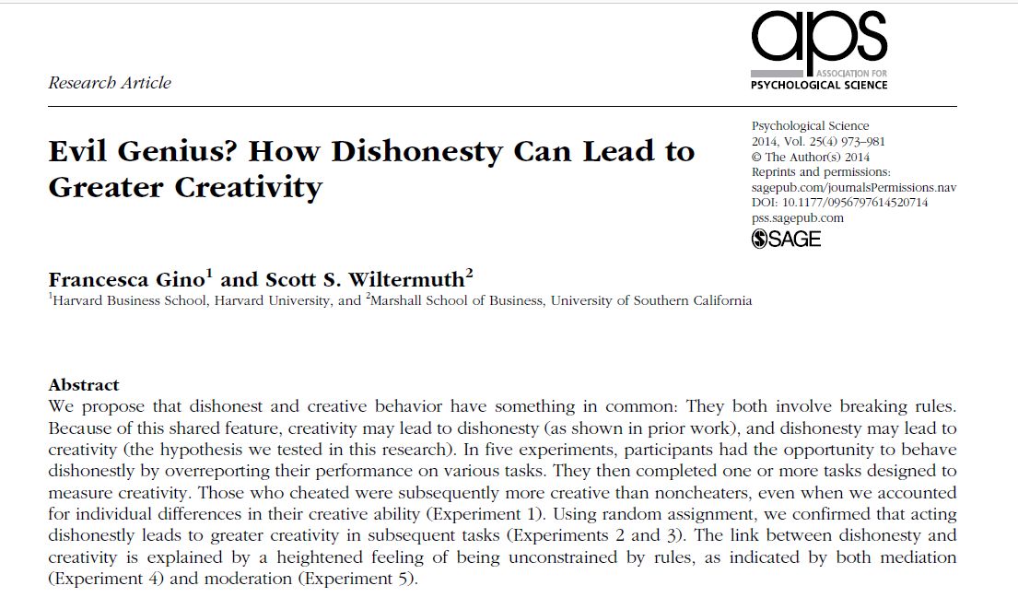

Slide 12
Operational definitions
Creativity
Remote Associates Test (RAT)
What is the common word that links
Sore, Shoulder, Sweat
Opera, Hand, Dish
Piece, Mind, Dating
Dishonesty
Experimentally controllable (or measurable) cheating or lying

Slide 13
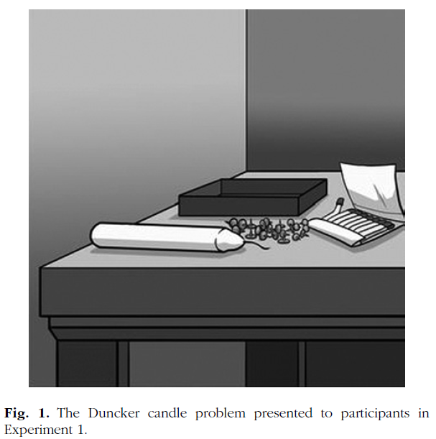
Experiment 1
Procedure
Dunker candle problem
Filler/cheatable task
10 matrices
Self-reported performance, paid
RAT performance
Results
Cheaters performed better on the RAT test

Slide 14
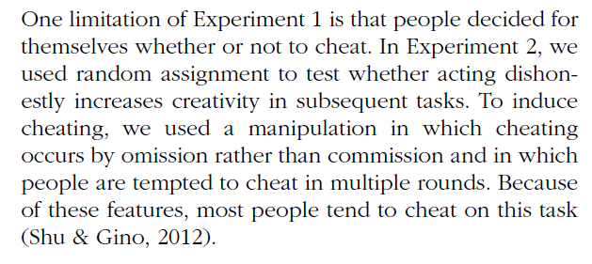
Experiment 2
How do you experimentally control cheating to be able to randomly assign participants to the “cheating” and control conditions?
Operational definition of this IV

Slide 15
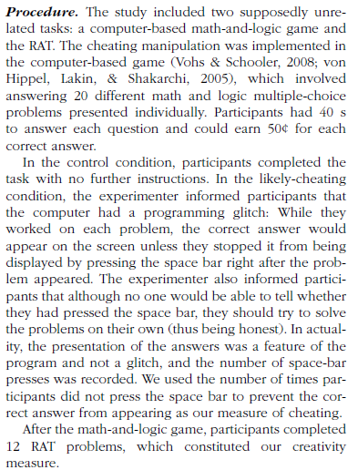
IV
DV

Slide 16
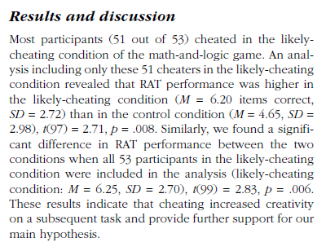
Effect size:
6.20 vs 4.65 problems solved
= 1.55 more
2 independent samples t-test

Slide 17
For Monday Jan 22
Chapter 8: Ethics
Assignment questions
Read Gino & Wiltermuth (2014)
Assignment questions, Experiments 3 & 4
Wednesday 10/12: Exam 1
Prior exams posted to Canvas as study aids

